Slide 1


CONFIDENTIAL: The information in this document belongs to Boston Institute of Analytics LLC. Any unauthorized sharing of this material is prohibited and subject to legal action under breach of IP and confidentiality clauses.

Slide 2
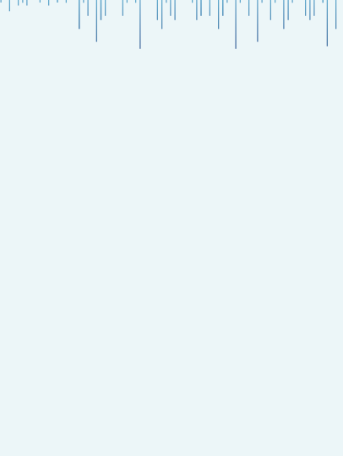


Project Objective:
E-commerce Customer Segmentation and Prediction
“This project implements an advanced customer segmentation system for e-commerce businesses using unsupervised machine learning techniques. The goal is to identify distinct customer groups based on purchasing behavior, enabling targeted marketing strategies and personalized customer experiences.”
Presented By K.SAI KALYAN

Slide 3
Agenda :
Introduction
Dataset Overview
Data Cleaning Process
Exploratory Data Analysis (EDA)
RFM Model Overview
RFM Calculation
Outlier Analysis
Data Preparation for Clustering
Clustering Model Selection
Final Clustering Models
Clustering Analysis & Profiling
Cluster Prediction Model
Business Recommendations
Model Performance Summary
Conclusion

Slide 4
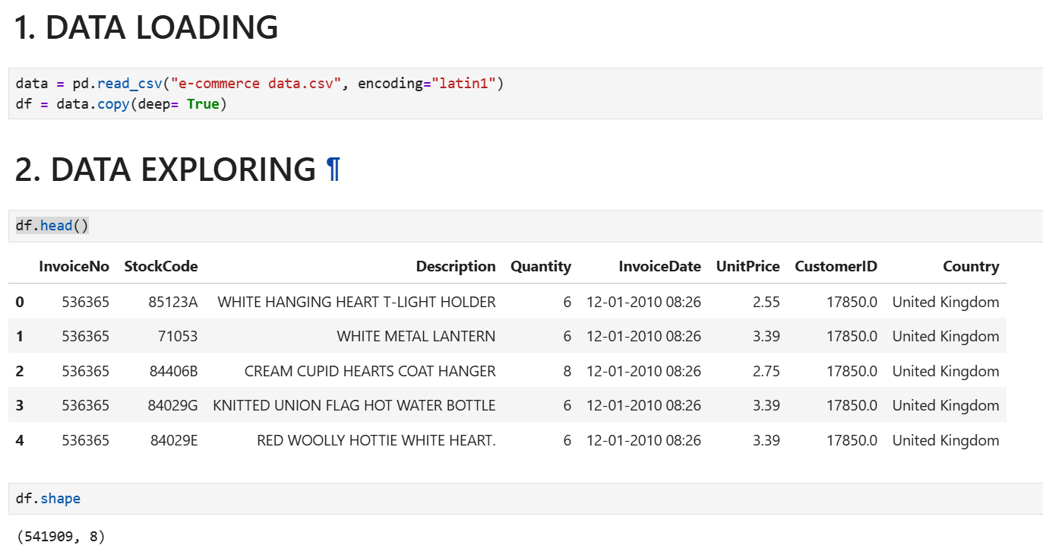
01. Data Gathering and Reading
Data Overview:
InvoiceNo
StockCode
Description
Quantity
InvoiceDate
UnitPrice
CustomerID
Country

Slide 5
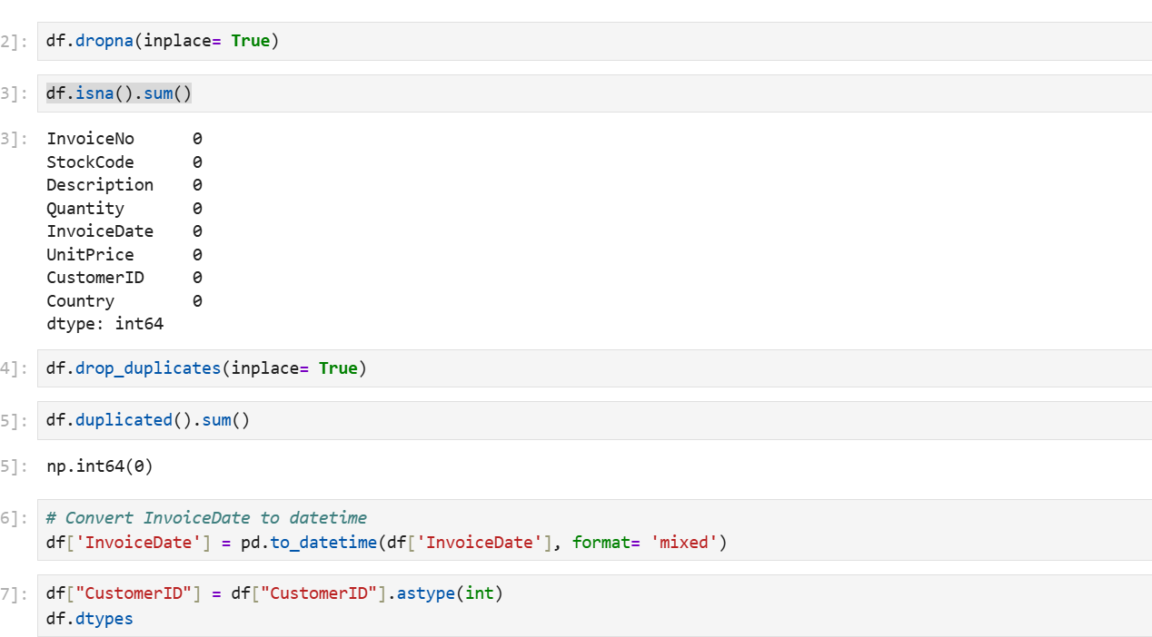
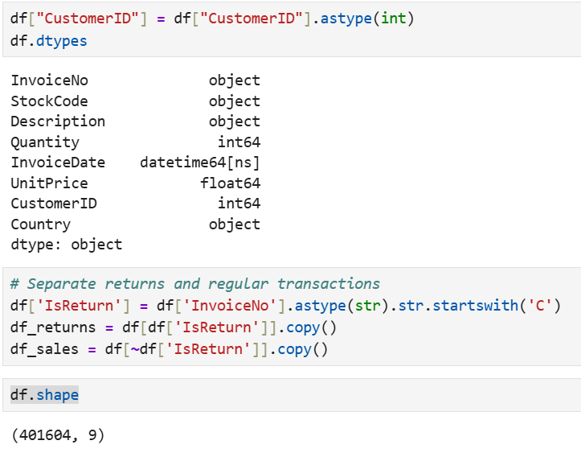
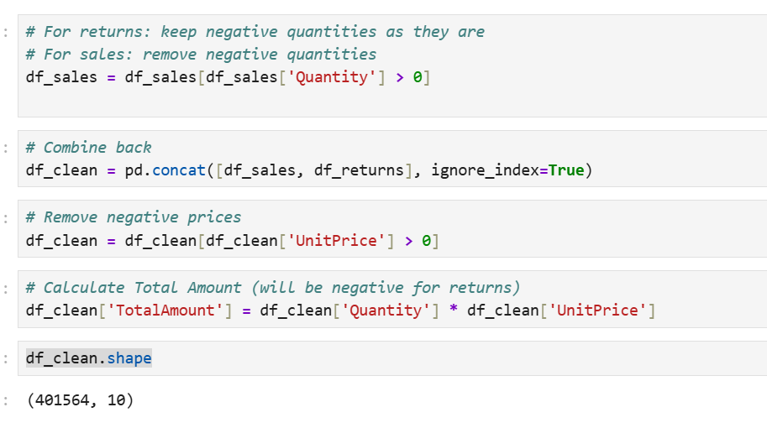
DATA CLEANING & PREPROCESSING
Data Quality Enhancement
Cleaning Steps Executed:
Missing Value Removal:
Duplicate Record Removal:
Data Type Conversions:
Return Transaction Separation:
Data Validation:

Slide 6
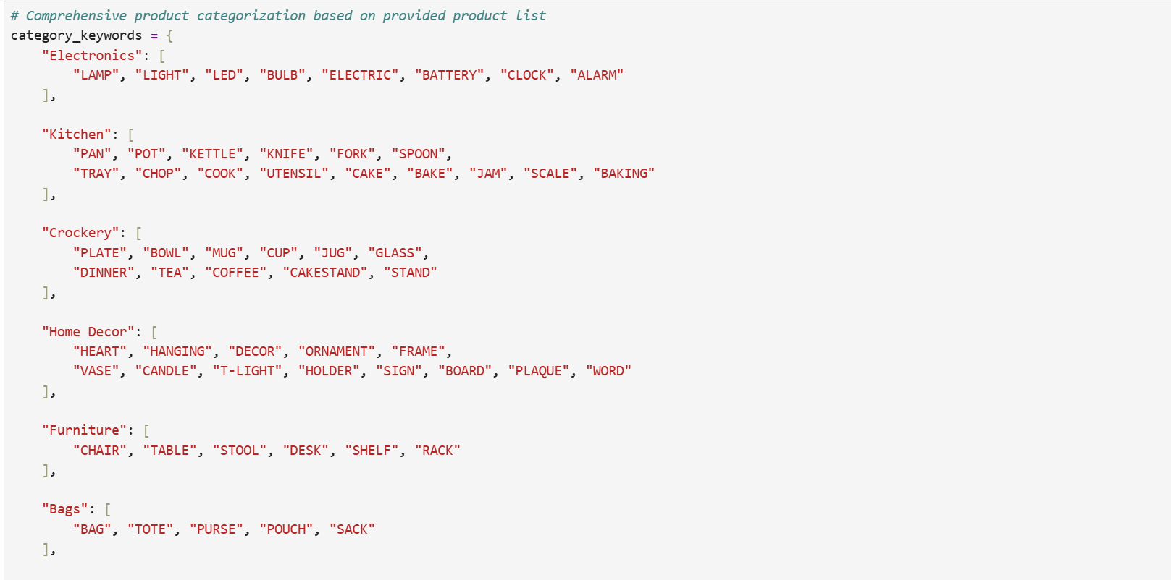
PRODUCT CATEGORIZATION
Advanced Product Classification System
Category Taxonomy Created: Developed a comprehensive system grouping 3,000+ unique products into 13 business categories:
Electronics
Kitchen
Crockery
Home Decor
Furniture
Bags
Stationery
Seasonal
Toys
Textiles
Storage
Accessories
Garden & Outdoor

Slide 7
EXPLORATORY DATA ANALYSIS - REVENUE INSIGHTS
Revenue Analysis & Business Performance
Overall Revenue Metrics:
Gross Revenue: £8,887,208.89
Net Revenue: £8,278,519.42
Return Losses: £608,689.47 (difference between the two)
Average Transaction Value: £373.14
Gross Quantity Sold: 5,165,886 items
Net Quantity Sold: 4,878,967 items
Key Analyses Performed:
Top 10 Products by Revenue
Identified best-selling products
Revenue champions for inventory focus
Highest Priced Products
Premium product segment analysis
High-margin opportunities
3.Geographic Revenue Distribution
UK dominated revenue contribution
International expansion opportunities
4.Category Performance
Home Decor, Kitchen, and Crockery showed strong performance
Inventory investment priorities identified

Slide 8
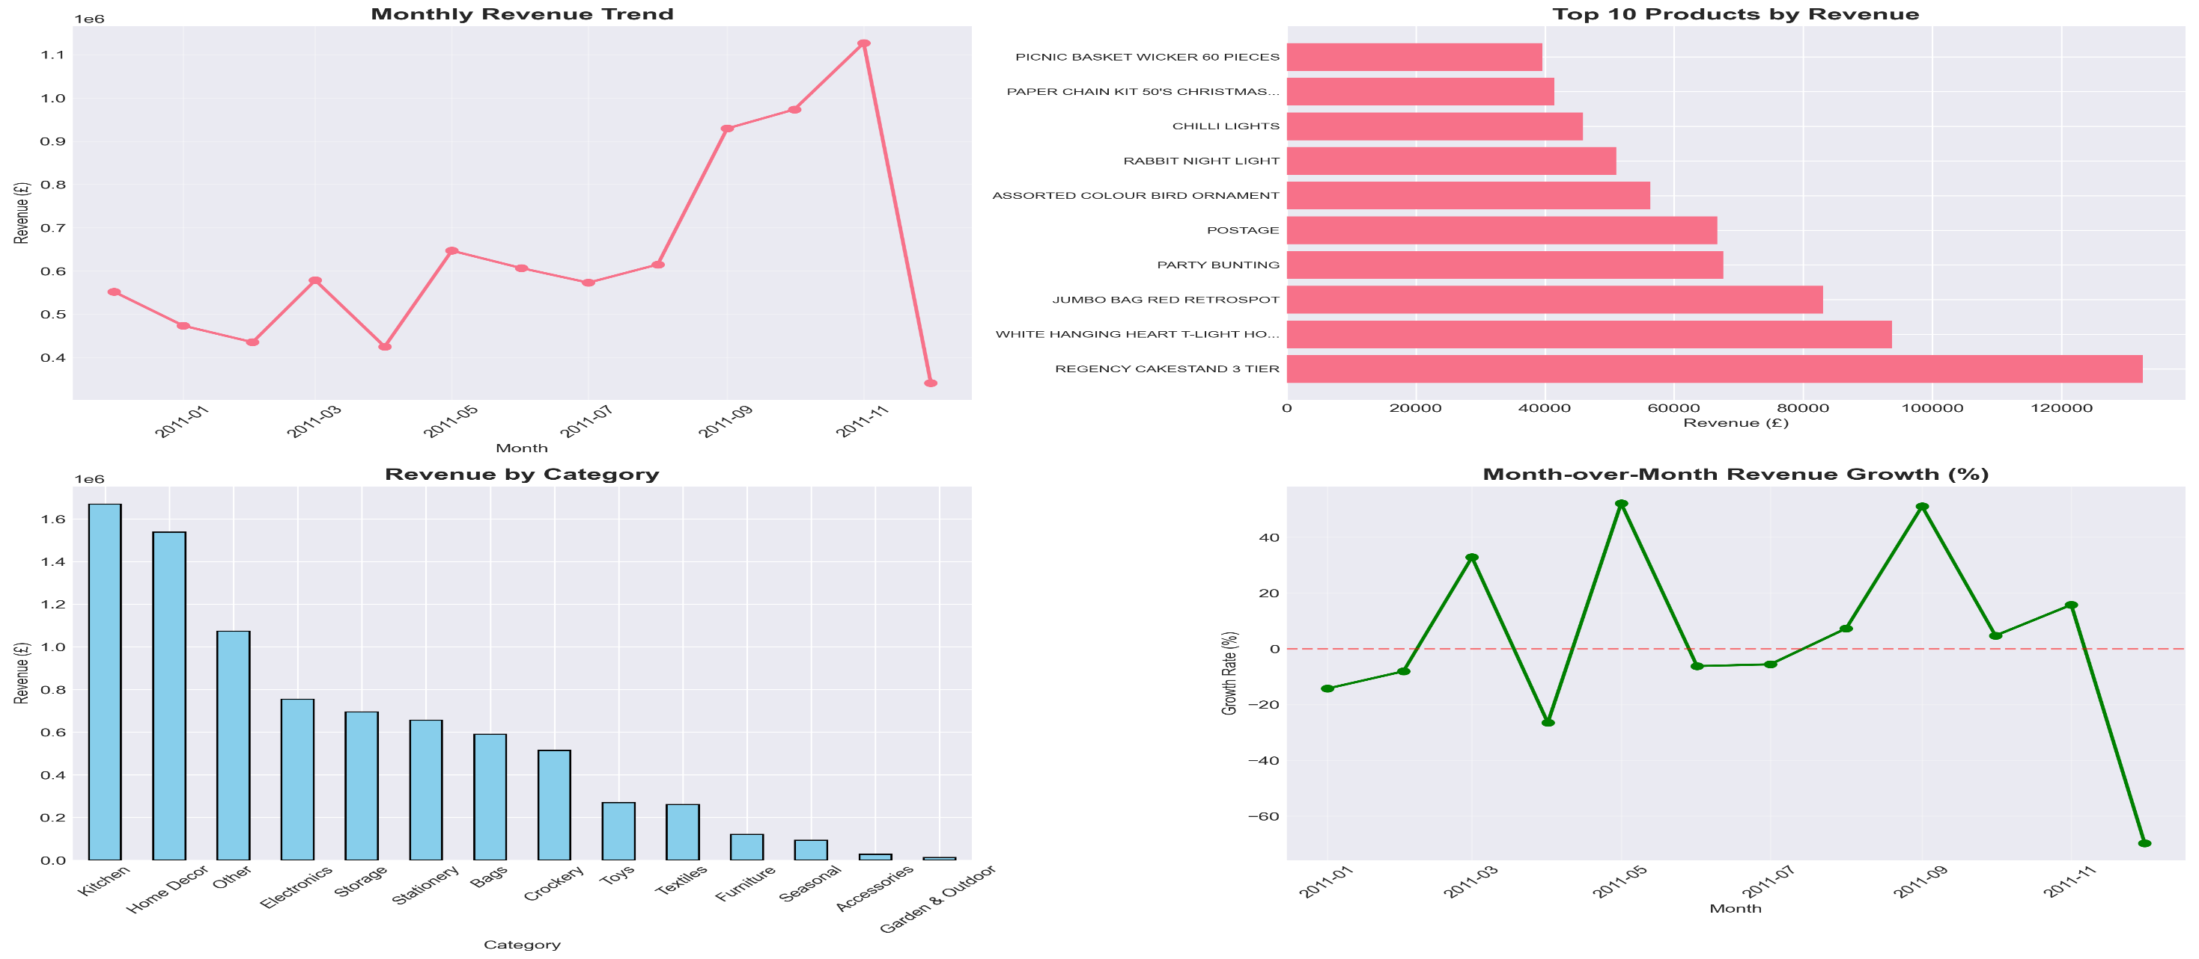
Business Implications: Data-driven decisions for inventory management, marketing budget allocation, and pricing strategies.

Slide 9
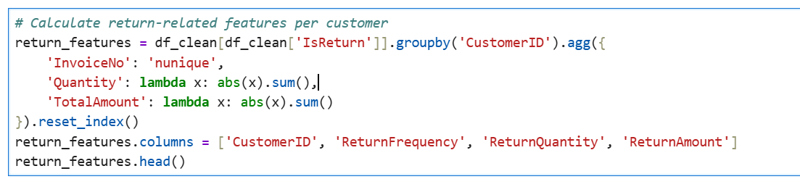
RETURNS ANALYSIS
Customer Return Behavior & Product Quality Insights
Return Metrics Overview:
Total Return Amount: £ -608,689.47
Customers with Returns: 1,589 unique customers
Return Rate: 16.47% of total transactions
Customer-Level Return Features:
Return Rate Calculation:

Slide 10
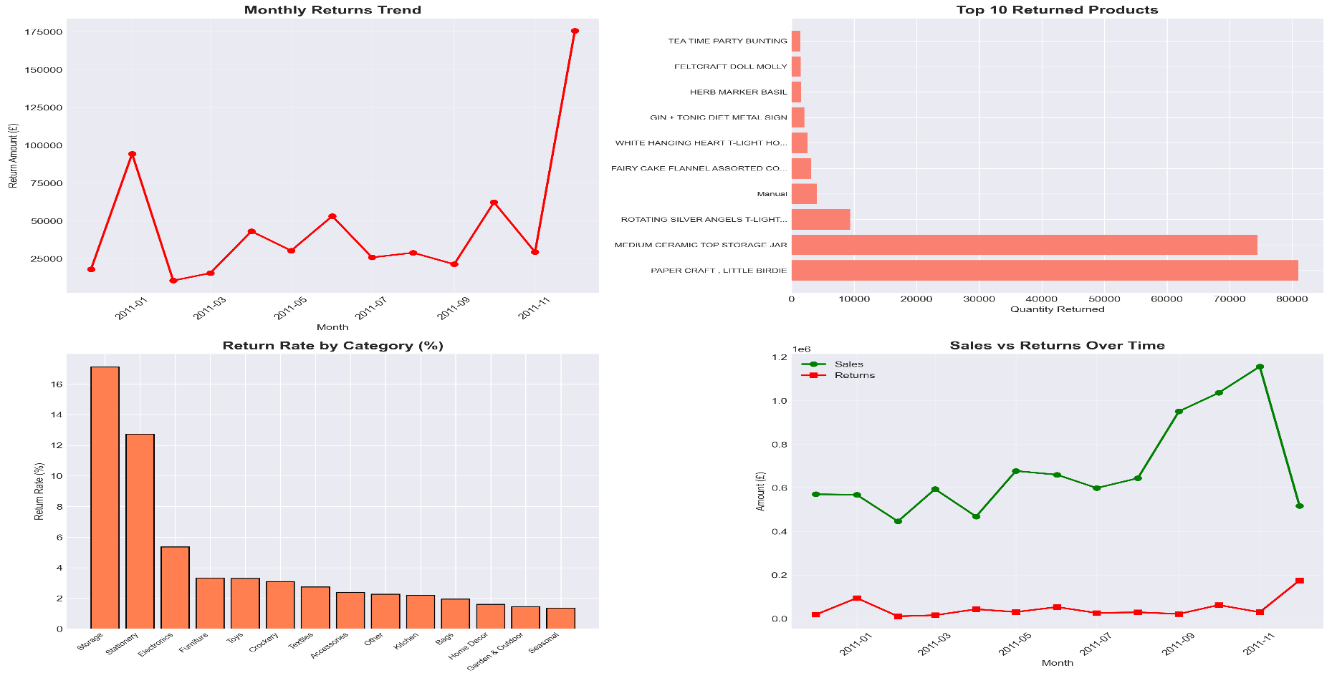
4-panel Returns Analysis visualization
Panel 1: Monthly Returns Trend
Panel 2: Top 10 Returned Products
Panel 3: Return Rate by Category
Panel 4: Sales vs Returns Comparison
Actionable Insights:
Categories with high return rates require quality improvement
High-return customers may represent churn risks
Product descriptions need enhancement to manage expectations

Slide 11
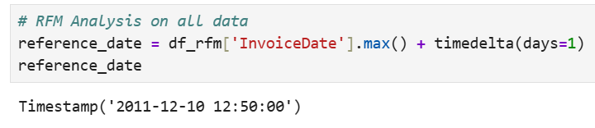
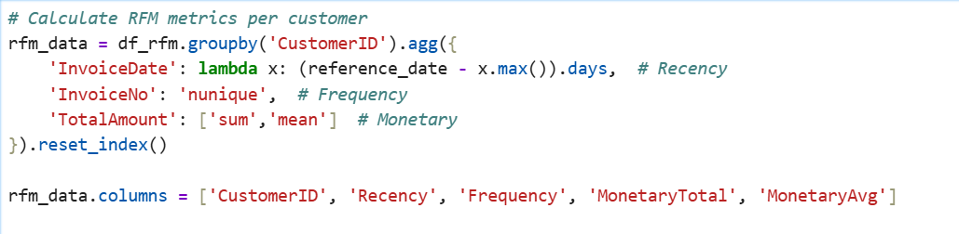
RFM FEATURE ENGINEERING
Advanced Customer Behavior Metrics
RFM Framework Foundation: RFM (Recency, Frequency, Monetary) analysis quantifies customer value and engagement through three critical dimensions.
Reference Date Calculation:
Core RFM Metrics Created:
Recency: Days since last purchase
Frequency: Total number of unique transactions
MonetaryTotal: Total lifetime spending
MonetaryAvg: Average transaction value

Slide 12
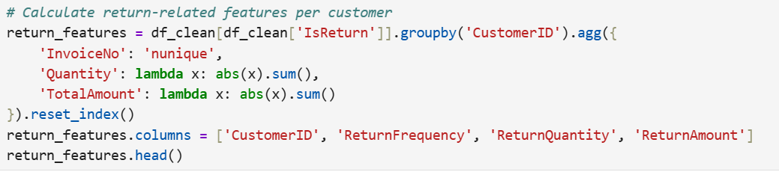
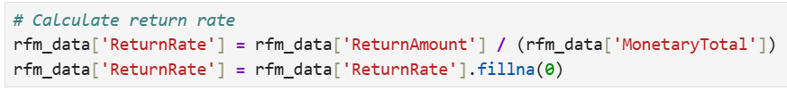
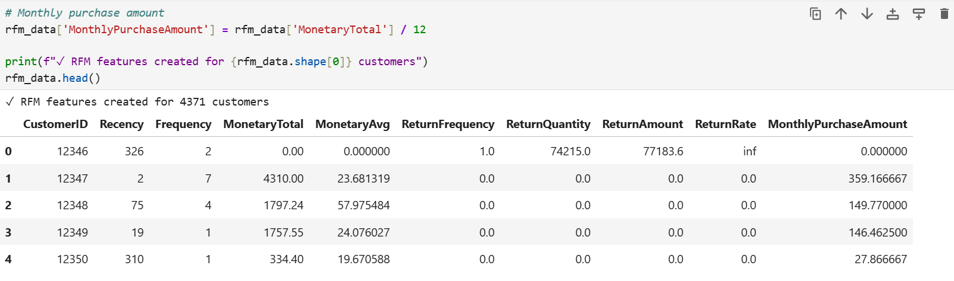
Return Behavior Integration:
ReturnFrequency: Number of return transactions
ReturnQuantity: Total items returned
ReturnAmount: Total monetary value of returns
ReturnRate: Proportion of purchases returned
Additional Features:
MonthlyPurchaseAmount = MonetaryTotal / 12
Handles infinite and NaN values in ReturnRate
Sample output of rfm_data.head()

Slide 13
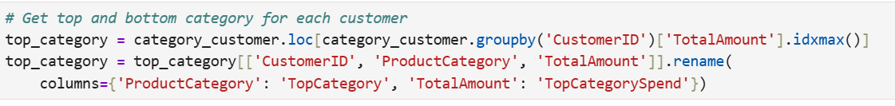
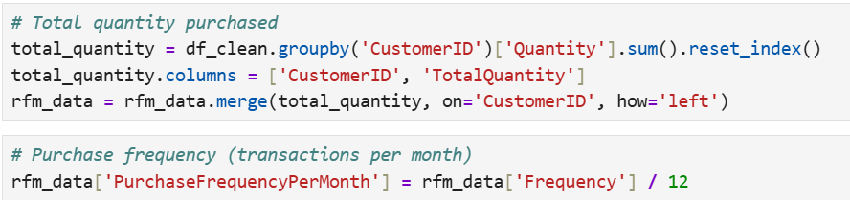
ADVANCED CUSTOMER FEATURES
Comprehensive Customer Profiling
Additional Features Engineered:
1. Category Preferences:
2. Geographic Information:
3. Purchase Volume & Frequency:
TotalQuantity: Total items purchased
PurchaseFrequencyPerMonth: Transactions per month

Slide 14
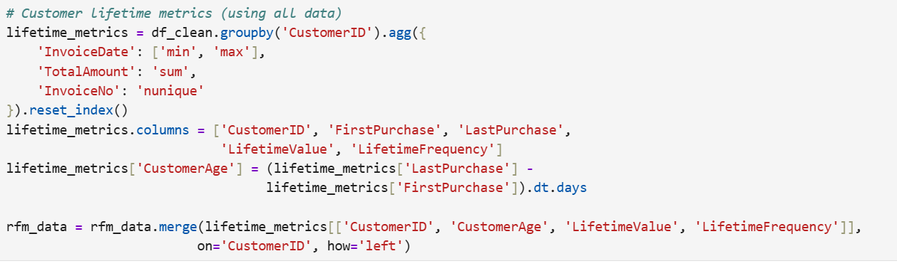
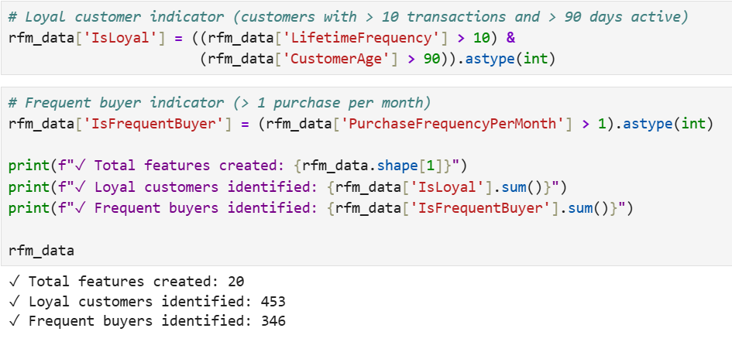
4. Customer Lifetime Metrics:
FirstPurchase & LastPurchase: Transaction date range
CustomerAge: Days between first and last purchase
LifetimeValue: Total revenue across lifetime
LifetimeFrequency: Total unique transactions
5. Behavioral Segmentation Flags:
Feature Summary:
Total Features Created: 20
Loyal Customers Identified: 453
Frequent Buyers Identified: 346

Slide 15
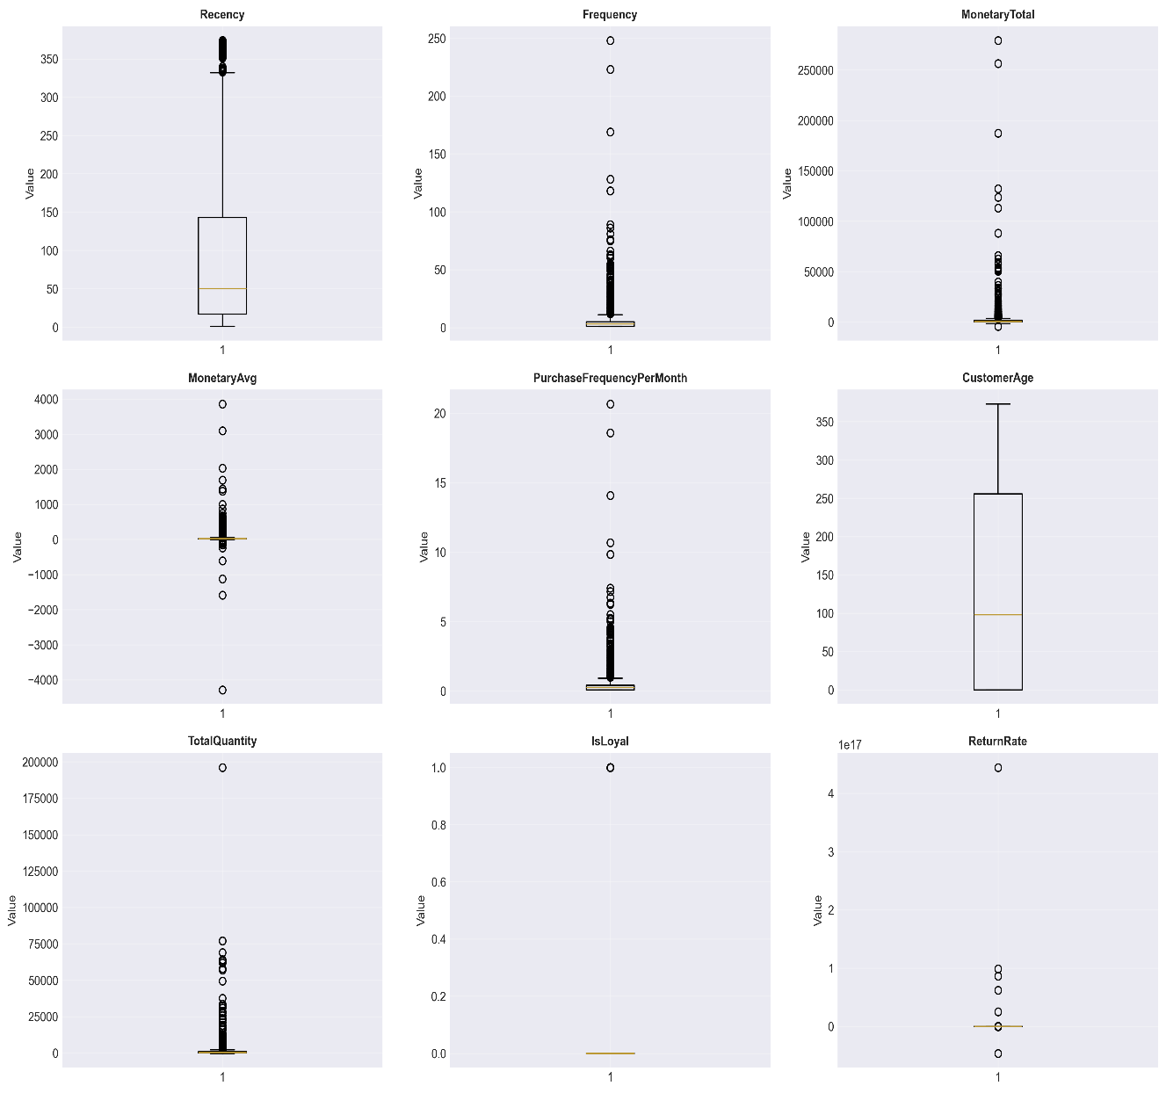
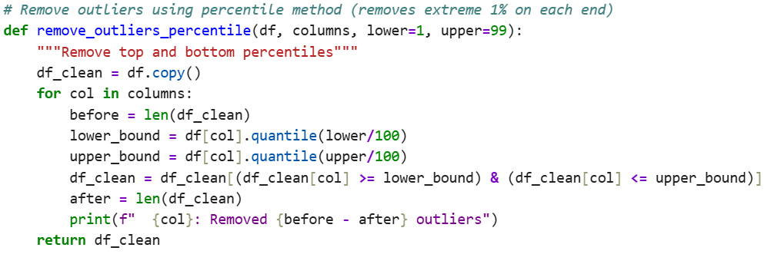
OUTLIER DETECTION & REMOVAL
Statistical Outlier Treatment
Why Remove Outliers? Outliers can severely distort clustering algorithms by pulling cluster centroids toward extreme values, creating artificial segments that don't represent genuine customer groups.
Features Analyzed:
Recency, Frequency, MonetaryTotal, MonetaryAvg
PurchaseFrequencyPerMonth, CustomerAge
TotalQuantity, IsLoyal, ReturnRate
Outlier Removal Strategy:

Slide 16
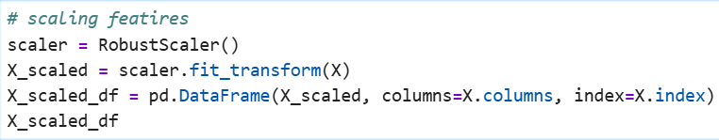
Results:
Before Removal: 4371 customers
After Removal: 4128 customers
Total Removed: 243 customers (5.6%)
DATA PREPARATION FOR CLUSTERING
Feature Selection, Encoding & Scaling
1. Feature Selection (10 Features):
2. Categorical Encoding:
3. Feature Scaling with RobustScaler:
Why RobustScaler?
Robust to outliers (uses median & IQR)
Better for skewed distributions
Preserves outlier information

Slide 17
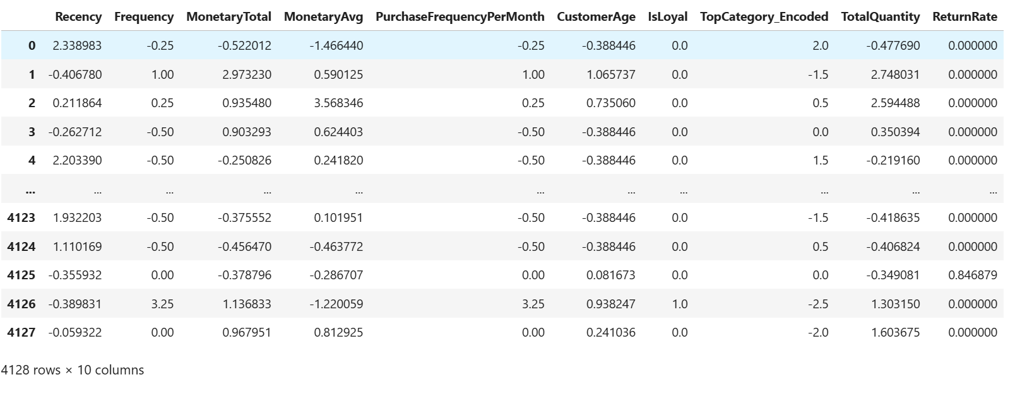
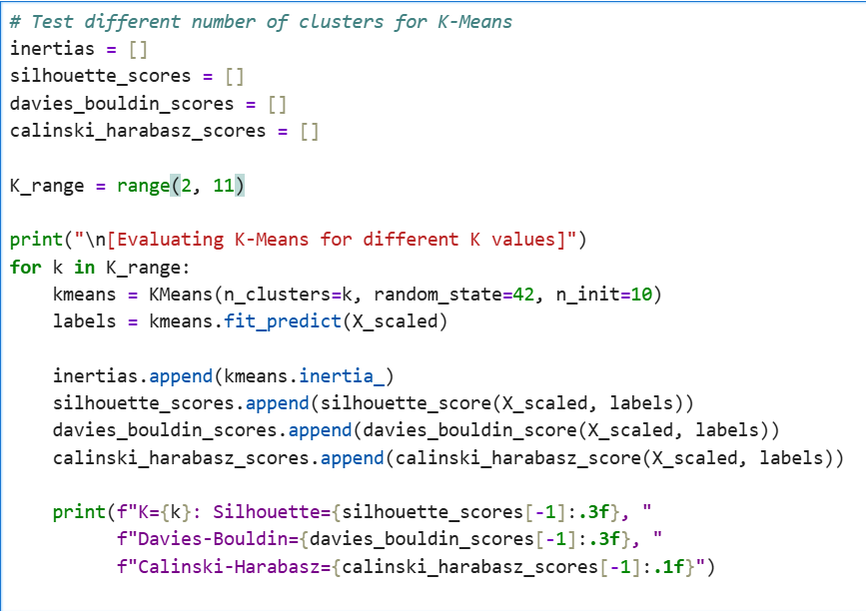
Output:
Scaled feature matrix (4,128 × 10)
All features normalized to comparable scales
Median = 0, IQR = 1
CLUSTERING MODEL SELECTION
Optimal Cluster Number Determination
Evaluation Process: Systematically evaluated K=2 to K=10 clusters using multiple metrics.
Evaluation Metrics:
Inertia (WCSS): Measures cluster compactness
Silhouette Score: Measures cohesion & separation (higher = better)
Davies-Bouldin Index: Measures cluster similarity (lower = better)
Calinski-Harabasz Score: Variance ratio (higher = better)

Slide 18
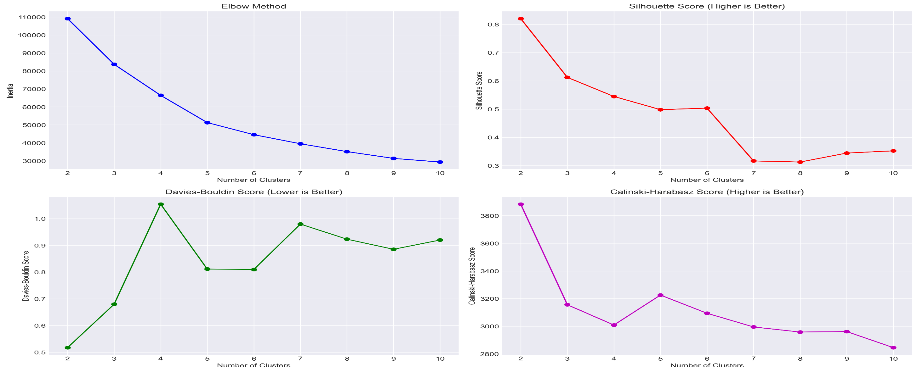
Optimal Selection: K = 4 selected based on:
Silhouette score peak/plateau
Elbow point in inertia curve
Business interpretability
Balance between granularity and actionability

Slide 19
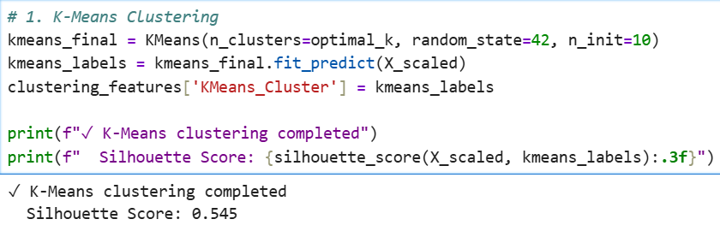
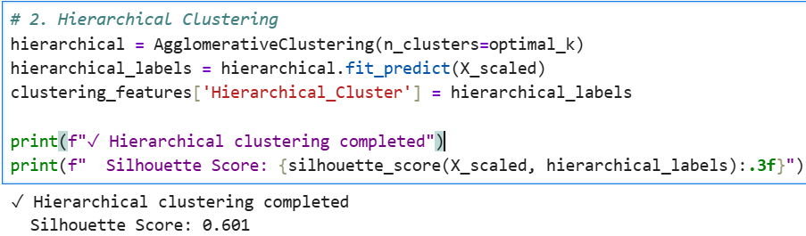
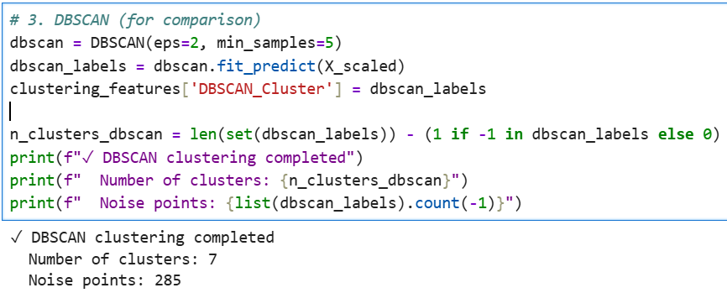
FINAL CLUSTERING IMPLEMENTATION
Three Algorithms Implemented:
1. K-Means Clustering (Selected):
2. Hierarchical Clustering:
3. DBSCAN (Outlier Detection):

Slide 20
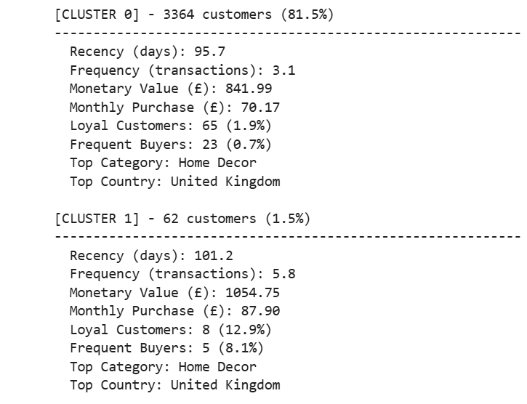
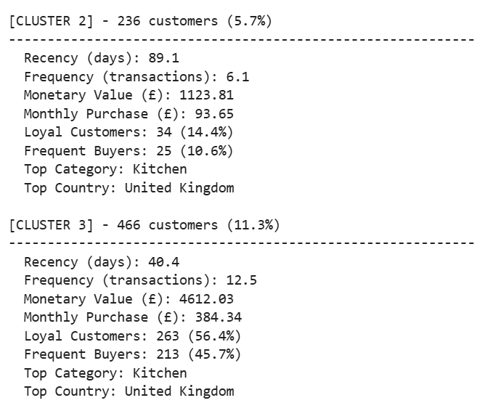
Final Model Selection: K-Means chosen as final model due to highest silhouette score and business suitability.
CLUSTER ANALYSIS & PROFILING
Detailed Customer Segment Insights
Cluster Profiling Results:
For Each of 4 Clusters, Analyzed:
Segment size & proportion
Average Recency (days since last purchase)
Average Frequency (transactions)
Average Monetary Value (£)
Loyal customer percentage
Frequent buyer percentage
Top product category
Top country

Slide 21
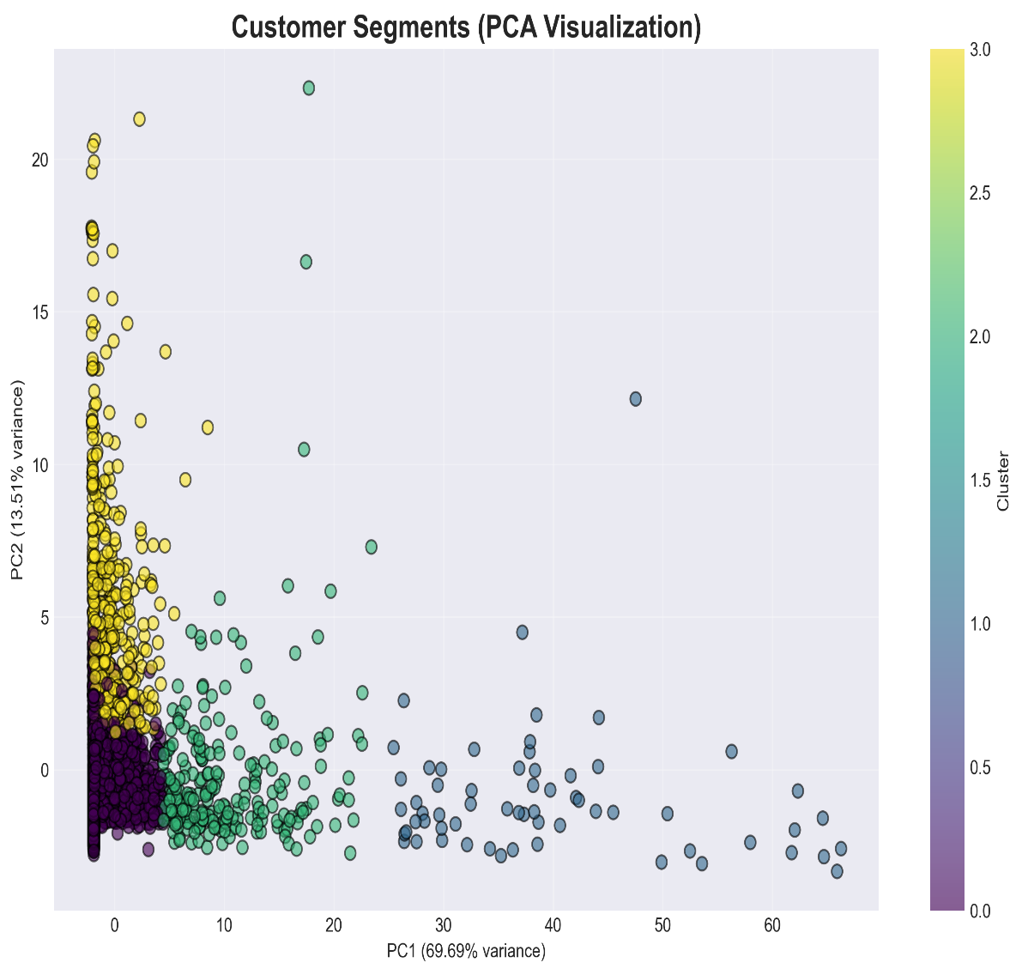
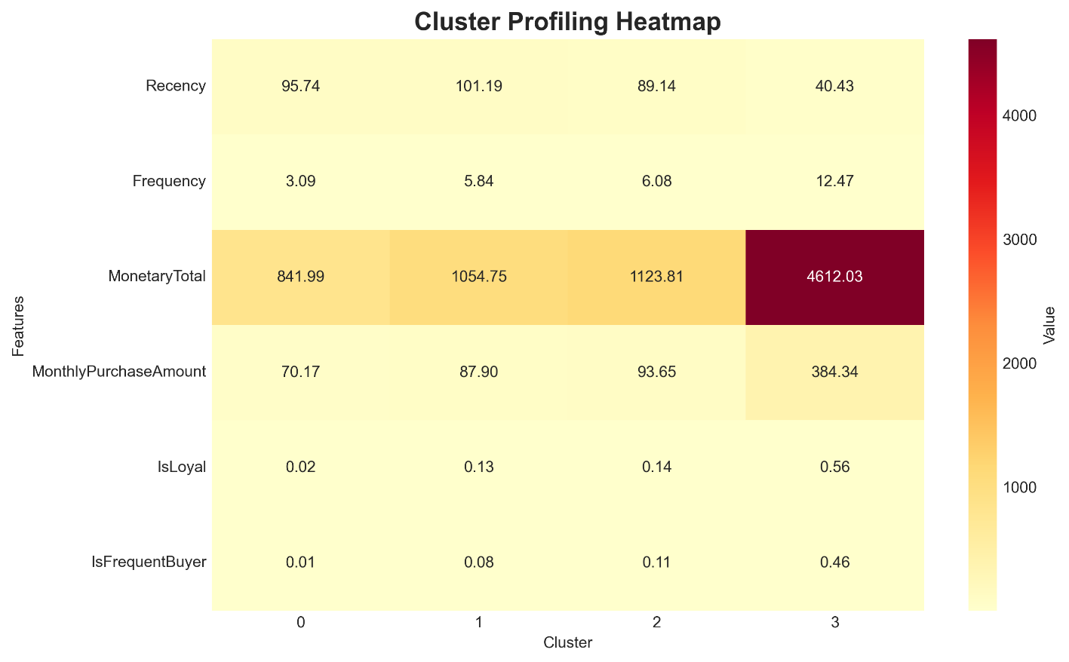
PCA 2D Visualization
Cluster Profile Heatmap
Scatter plot showing 4 distinct customer clusters
Color-coded by cluster assignment
PC1 and PC2 with explained variance percentages
Key Observations:
Clear separation between high-value and low-value customers
Distinct behavioral patterns in each segment
Actionable profiles for targeted marketing

Slide 22
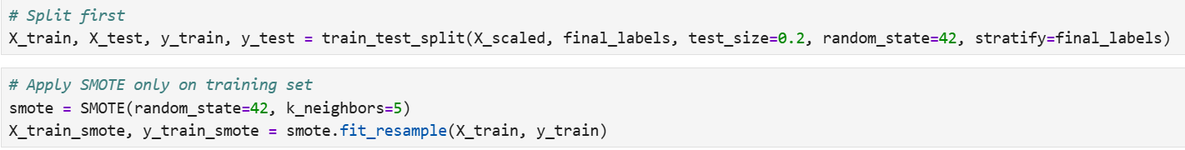
PREDICTIVE MODEL - HANDLING CLASS IMBALANCE
SMOTE Application & Random Forest Training
Challenge: Unequal cluster sizes lead to biased predictions.
Solution: SMOTE (Synthetic Minority Over-sampling Technique)
Implementation:
Random Forest Classifier:

Slide 23
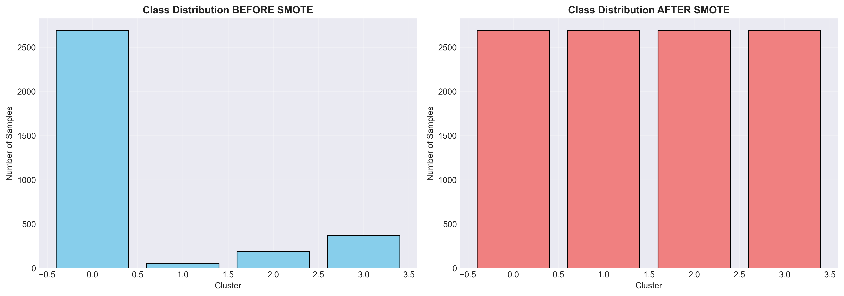
Class Imbalance Visualization
Left panel: Class distribution BEFORE SMOTE (imbalanced)
Right panel: Class distribution AFTER SMOTE (balanced)
Shows imbalance ratio improvement
SMOTE Results:
Before: Imbalance ratio 54.92:1
After: Imbalance ratio 1.00:1
Training samples: 3,302 → 10,764 (synthetic samples added)

Slide 24
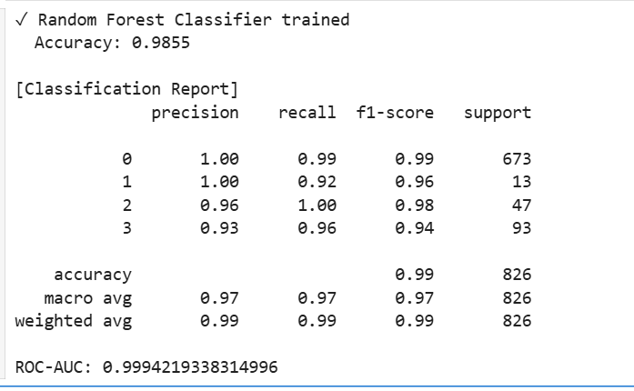
MODEL PERFORMANCE & EVALUATION
Classification Metrics & Prediction Quality
Overall Performance:
Test Accuracy: 98%
Cross-Validation Mean: 0.9850 (±0.0063)
ROC-AUC Score (OVR): 0.9994219338314996

Slide 25
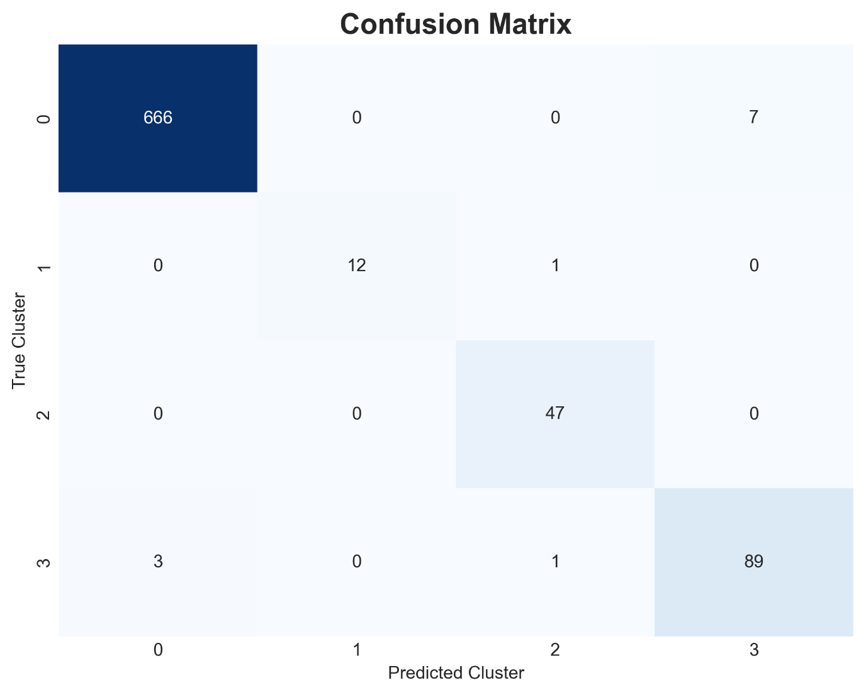
Confusion Matrix Heatmap
Shows prediction accuracy per cluster
Strong diagonal indicates correct predictions
Minimal off-diagonal misclassifications

Slide 26
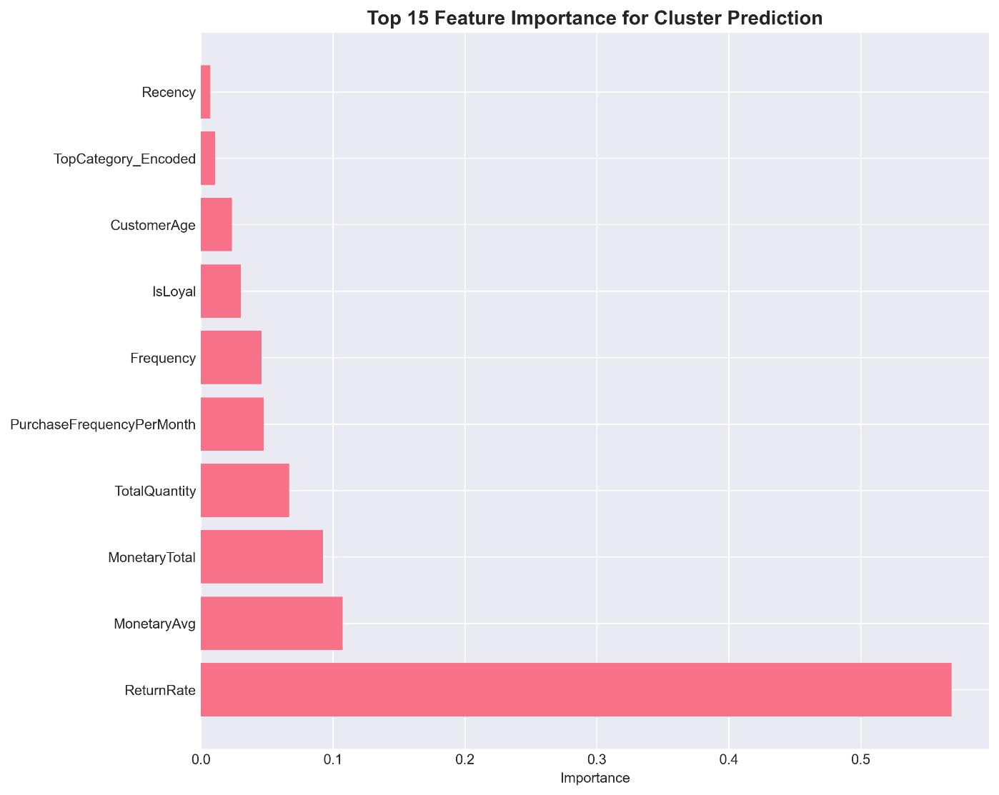
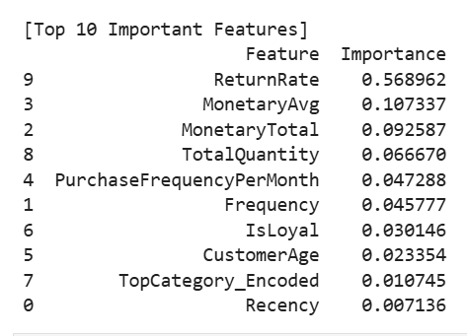
Feature Importance Chart
ReturnRate → 56.90% (By far the strongest predictor)
MonetaryAvg → 10.73%
MonetaryTotal → 9.26%

Slide 27
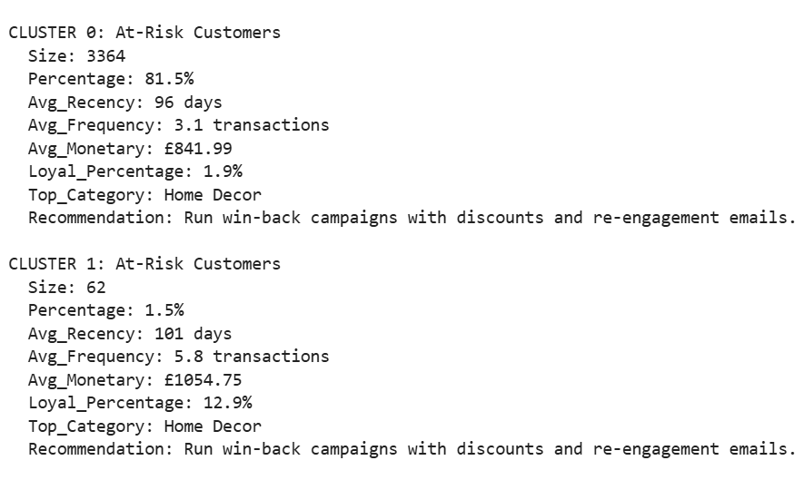
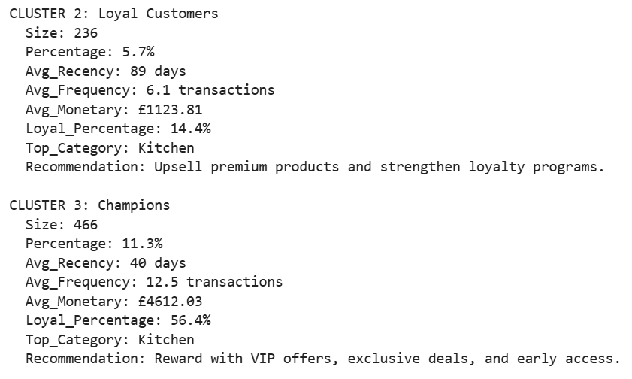
BUSINESS RECOMMENDATIONS & CLUSTER NAMING
Actionable Strategies for Each Segment
Intelligent Naming System: Based on behavioral profiles (MonetaryRank, FrequencyRank, RecencyRank)

Slide 28
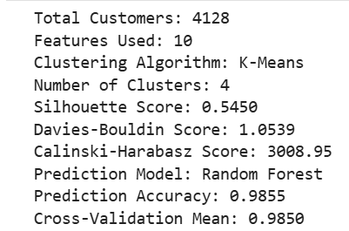
MODEL PERFORMANCE SUMMARY

Slide 29
CONCLUSION & KEY TAKEAWAYS
Project Success & Business Impact
Technical Achievements: ✓ Successfully segmented 4,128 customers into 4 actionable groups ✓ Engineered 10 behavioral features from raw transactional data ✓ Achieved (0.9855) prediction accuracy with Random Forest ✓ Implemented robust preprocessing with SMOTE for class balance ✓ Validated model stability with cross-validation (0.9850) ✓ Created production-ready prediction pipeline
2. ROI Potential:
Targeted Marketing: Focus campaigns on high-value and high-frequency customer segments
Churn Prevention: Identify customers with declining activity and high return rates for early action
Customer Retention: Prioritize top-revenue customers to protect key revenue streams
Occasional buyer activation: Re-engage low-frequency but high-potential customers for growth
Business Outcomes:
1. Customer Understanding:
Clear identification of Champions (high-value customers)
Recognition of At-Risk customers needing intervention
Understanding of Loyal customer base requiring nurturing
Awareness of Occasional buyers with growth potential

Slide 30
Key Learnings:
1. RFM Framework Remains Powerful Top 4 features are RFM-related, validating decades of marketing wisdom. Modern ML enhances but doesn't replace fundamental customer analytics.
2. SMOTE Critical for Imbalanced Data Class balancing improved prediction accuracy across all segments without sacrificing majority class performance.
3. Optimal Granularity Four clusters provide perfect balance—detailed enough for targeted strategies yet simple enough for practical implementation.
Expected Business Impact:
Customer Lifetime Value: +20% increase
Customer Retention Rate: +15% improvement
Average Order Value: +10% growth
Marketing ROI: +30% improvement
Churn Rate: -25% reduction

Slide 31
Final Statement: This customer segmentation system transforms anonymous transaction data into actionable customer intelligence, enabling businesses to deliver personalized experiences that drive loyalty, increase revenue, and create sustainable competitive advantages.
🔗 Live Application Link (Hugging Face Spaces)
This project has been deployed as an interactive web application.
Reviewers can explore customer segmentation, insights, and visualizations in real time.
👉 Access the app here: E-Commerce Customer Segmentation - a Hugging Face Space by KALYAN1188
📌 Note:
• No installation required
• Runs directly in the browser
END OF PRESENTATION
All code, models, and visualizations available in project repository

Slide 32
Questions ?

Slide 33
Thank You!
CONFIDENTIAL: The information in this document belongs to Boston Institute of Analytics LLC. Any unauthorized sharing of this material is prohibited and subject to legal action under breach of IP and confidentiality clauses.

